Slide 1


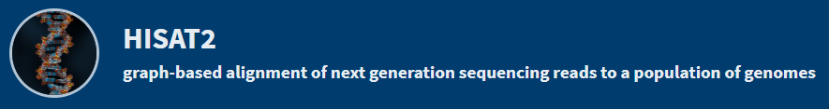

RNAseq analysis
Samuel Gurr
BIO 594: Using genomic techniques to examine the evolution of populations
April 13th, 2022
tag
Seq

Slide 2
Objectives
(I) Intro to RNAseq
Goals and how it works
Platforms, RNAseq vs. TagSeq
pros and cons
(II) Workflow
from HPC to R
(III) WGCNA in R
tips on multivariate analysis

Slide 3
Objectives
(I) Intro to RNAseq
Goals and how it works
Platforms, RNAseq vs. TagSeq
pros and cons
(II) Workflow
from HPC to R
(III) WGCNA in R
tips on multivariate analysis

Slide 4
Objectives
(I) Intro to RNAseq
Goals and how it works
Platforms, RNAseq vs. TagSeq
pros and cons
(II) Workflow
from HPC to R
(III) WGCNA (weighted gene correlation network analysis)
about this multivariate approach
…a dataset for our practical exercise!

Slide 5
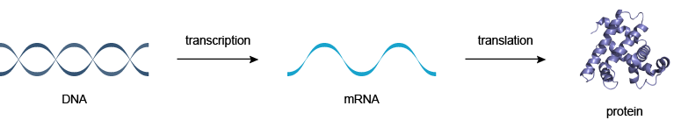
Goals of RNA-seq
Notes:
Central dogma background
We all know proteins are essential and transcriptional response reflects resiliance or susceptibility to external stimuli
Very important sequencing tool to understand the molecular and gene coding response

Slide 6
Goals of RNA-seq
the template, complimentary to DNA, used to assemble chains of amino acids (proteins!)
Notes:
Central dogma background
We all know proteins are essential and transcriptional response reflects resiliance or susceptibility to external stimuli
Very important sequencing tool to understand the molecular and gene coding response

Slide 7
Goals of RNA-seq
‘transcriptome’ embodies the full snapshot of expressed genes at a given time point
response to
experimental conditions
response at the population level
Notes:
Central dogma background
We all know proteins are essential and transcriptional response reflects resiliance or susceptibility to external stimuli
Very important sequencing tool to understand the molecular and gene coding response

Slide 8
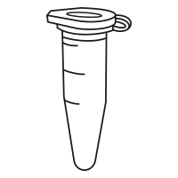

Platforms
RNAseq – the ‘gold’ standard or whole mRNAseq
✓
after sequenced…
isolate or enrich mRNA
fragmented
for high-throughput sequencing
(i.e. Illumina)
overlapping portions of the entire length
generates seq libraries of the whole transcript
Notes:
Central dogma background
We all know proteins are essential and transcriptional response reflects resiliance or susceptibility to external stimuli
Very important sequencing tool to understand the molecular and gene coding response

Slide 9
Platforms
RNAseq – the ‘gold’ standard or whole mRNAseq
Pros
you have it all!
de novo transcriptome assembly
d/n require an annotated reference
great for non-model organisms
✓
after sequenced…
novel transcript identification
detect low abundance transcripts
overlapping portions of the entire length
generates seq libraries of the whole transcript
Notes:
Identify isoforms and novel transcripts etc.
Splice variation transcript sequence etc.

Slide 10

Platforms
Cons
you have it… all…
✓
after sequenced…
overlapping portions of the entire length
generates seq libraries of the whole transcript
Notes:
Central dogma background
We all know proteins are essential and transcriptional response reflects resiliance or susceptibility to external stimuli
Very important sequencing tool to understand the molecular and gene coding response

Slide 11
Platforms
Cons
you have it… all…
requires high depth of coverage
paired-end sequencing
~30 million raw reads per sample
cost!
$400 - $1000 per sample
additional expense for replication
data size
- complicates storage and analysis
✓
after sequenced…
overlapping portions of the entire length
generates seq libraries of the whole transcript
Notes:
Biased for gene length!!!

Slide 12


Platforms
Cons
you have it… all…
requires high depth of coverage
paired-end sequencing
~30 million raw reads per sample
cost!
$400 - $1000 per sample
additional expense for replication
data size
- complicates storage and analysis
Only 8 samples per lane!!
$1500-2300
Notes:
Central dogma background
We all know proteins are essential and transcriptional response reflects resiliance or susceptibility to external stimuli
Very important sequencing tool to understand the molecular and gene coding response

Slide 13
Platforms
TagSeq – 3’ end biased sequencing
isolate or enrich mRNA
fragmented
polyA
enrichment
Notes:
Central dogma background
We all know proteins are essential and transcriptional response reflects resiliance or susceptibility to external stimuli
Very important sequencing tool to understand the molecular and gene coding response

Slide 14
Platforms
TagSeq – 3’ end biased sequencing
isolate or enrich mRNA
fragmented
polyA
enrichment
Polyadenation and the ‘polyA tail’ – a stretch of successive adenine bases on the 3’ end of mature mRNA
polyA is not translated
fxn: stability, prevents degradation by phosphates and nucleases,
required when exported from nucleus → cytosol
Notes:
Central dogma background
We all know proteins are essential and transcriptional response reflects resiliance or susceptibility to external stimuli
Very important sequencing tool to understand the molecular and gene coding response

Slide 15
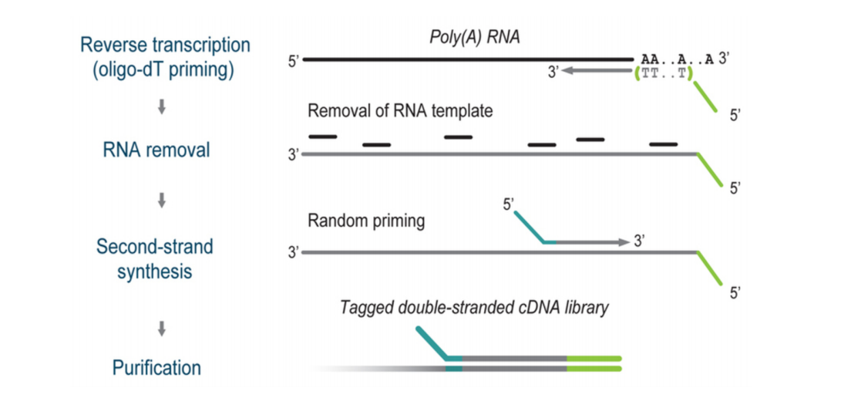
Platforms
Notes:
Oligo dT primer single stranded seq using for priming reverse transcriptase in the 3’5 direction starting from the polyA tail
Rverse transcriptase RNA dependent DNA polymerase – transcribes ssRNA to cDNA

Slide 16
Platforms
TagSeq – 3’ end biased sequencing
✓
3’
ref_gene2
3’
ref_gene1
after sequenced…
isolate or enrich mRNA
fragmented
polyA
enrichment
Generates a single library molecule per transcript
Notes:
Central dogma background
We all know proteins are essential and transcriptional response reflects resiliance or susceptibility to external stimuli
Very important sequencing tool to understand the molecular and gene coding response

Slide 17
Platforms
TagSeq – 3’ end biased sequencing
Pros
Lower sequencing cost
Higher capacity for replication
Ideal sequencing tool for differential gene expression (DGE)
✓
ref_gene2
ref_gene1
after sequenced…
Generates a single library molecule per transcript
Notes:
Central dogma background
We all know proteins are essential and transcriptional response reflects resiliance or susceptibility to external stimuli
Very important sequencing tool to understand the molecular and gene coding response

Slide 18
Platforms
TagSeq – 3’ end biased sequencing
Cons
Requires a reference with good annotation
- no de novo
No insight on splicing or novel transcripts
Additional trimming to remove polyA
✓
ref_gene2
ref_gene1
after sequenced…
Generates a single library molecule per transcript
Notes:
Central dogma background
We all know proteins are essential and transcriptional response reflects resiliance or susceptibility to external stimuli
Very important sequencing tool to understand the molecular and gene coding response

Slide 19
Takeaways
RNAseq
TagSeq
generates overlapping fragments of the whole transcript
Generates a single library molecule per transcript
Costly
Biased of transcript length
Low replication (unless you have the cash)
Ideal for non-model taxa and exploratory transcriptomics
Cuts cost dramatically
High replication
Limited to differential expression analysis
Requires a reference
Tip: watch out for the polyA tail!
Notes:
Central dogma background
We all know proteins are essential and transcriptional response reflects resiliance or susceptibility to external stimuli
Very important sequencing tool to understand the molecular and gene coding response

Slide 20
Takeaways
RNAseq
TagSeq
generates overlapping fragments of the whole transcript
Generates a single library molecule per transcript
Costly
Biased of transcript length
Low replication (unless you have the cash)
Ideal for non-model taxa and exploratory transcriptomics
Cuts cost dramatically
High replication
Limited to differential expression analysis
Requires a reference
Tip: watch out for the polyA tail!
Notes:
Central dogma background
We all know proteins are essential and transcriptional response reflects resiliance or susceptibility to external stimuli
Very important sequencing tool to understand the molecular and gene coding response

Slide 21
Why use TagSeq?
Complex experiments need high replication…
response to experimental conditions
response at the population level
B
A
C
temp_1
temp_2
temp_3

Slide 22
Why use TagSeq?
If you..
(1) have a well-annotated reference
(2) are only interested in gene expression
response to experimental conditions
response at the population level
Seq
B
A
C
temp_1
temp_2
temp_3

Slide 23
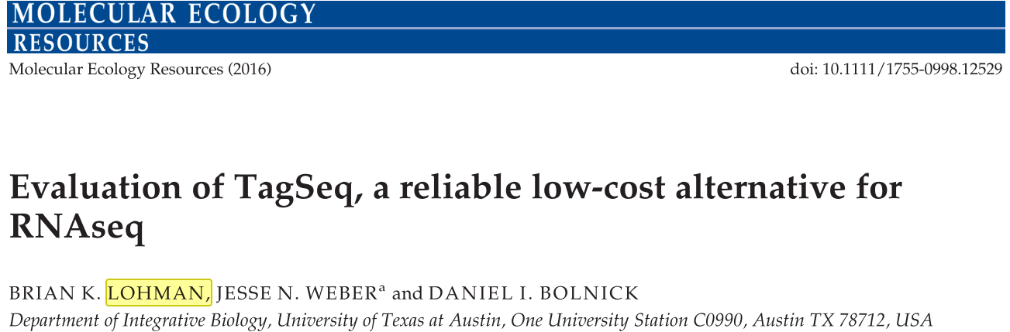
Lohman et al. 2016
About:

Slide 24
Objectives
(I) Intro to RNAseq
Goals and how it works
Platforms, RNAseq vs. TagSeq
pros and cons
(II) Workflow
from HPC to R
(III) WGCNA in R
tips on multivariate analysis

Slide 25
Workflow
bioinformatics pun here
Erin Chile’s github “on blast”
https://github.com/echille/Mcapitata_Developmental_Gene_Expression_Timeseries/blob/master/1-QC-Align-Assemble/mcap_rnaseq_analysis.md
https://github.com/echille/Montipora_OA_Development_Timeseries/blob/master/Amil/amil_RNAseq-analysis.sh
HPC = high-performance computing cluster
https://web.uri.edu/hpc-research-computing/using-bluewaves/

Slide 26
Workflow
‘clean’ data
raw data

Slide 27
Workflow
‘clean’ data
raw data
Upon upload to HPC…
Cross-validate digital fingerprint (md5sum)
quality check and visualize report
QC and trim
i.e. fastp, trimmomatic, fastQC, etc..
report using
multiQC

Slide 28
Workflow
‘clean’ data
raw data
Upon upload to HPC…
Cross-validate digital fingerprint (md5sum)
quality check and visualize report
QC and trim
i.e. fastp, trimmomatic, fastQC, etc..
report using
multiQC

Slide 29
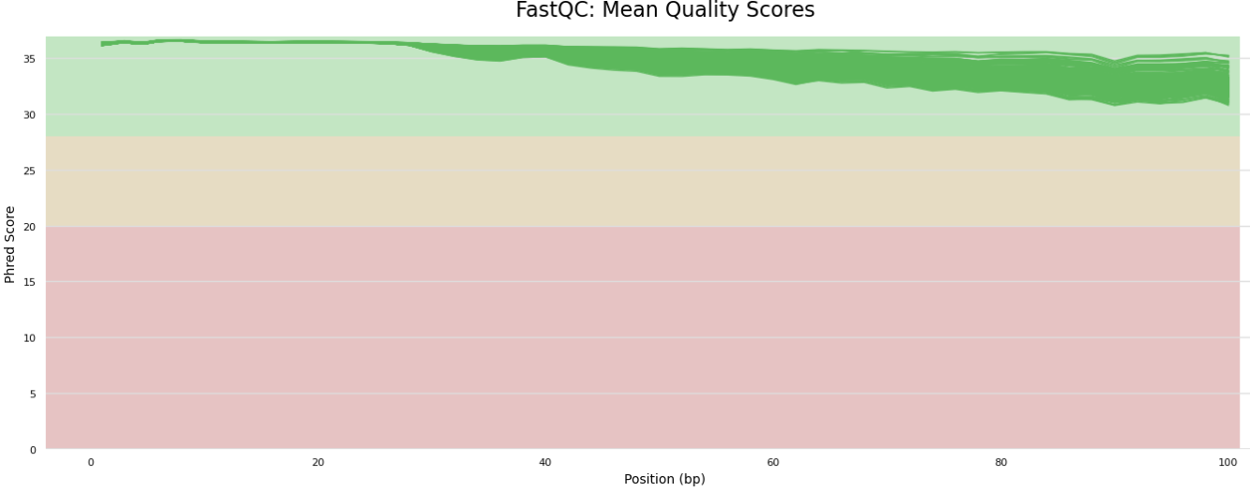
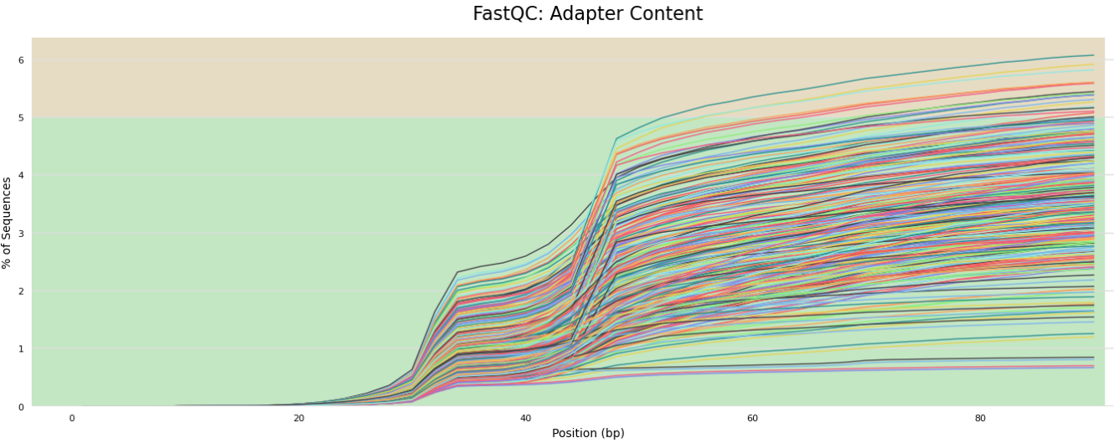
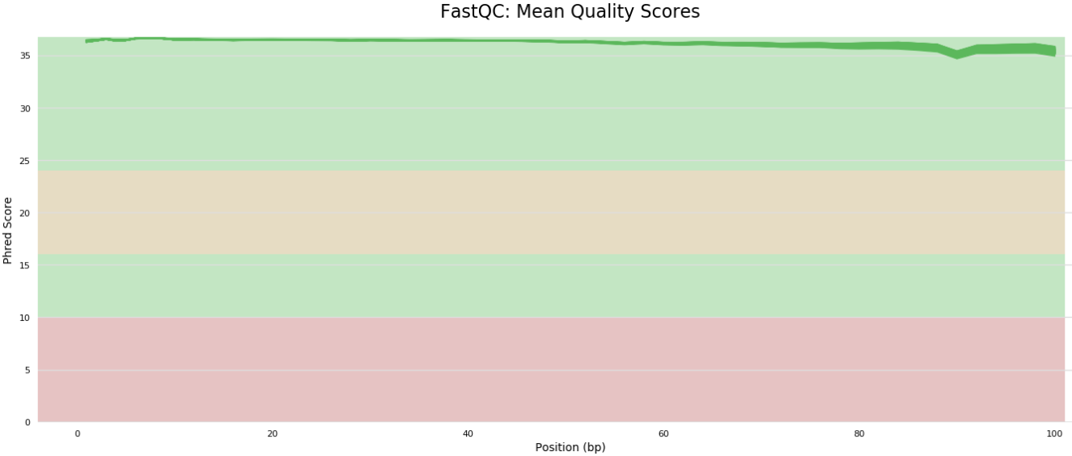
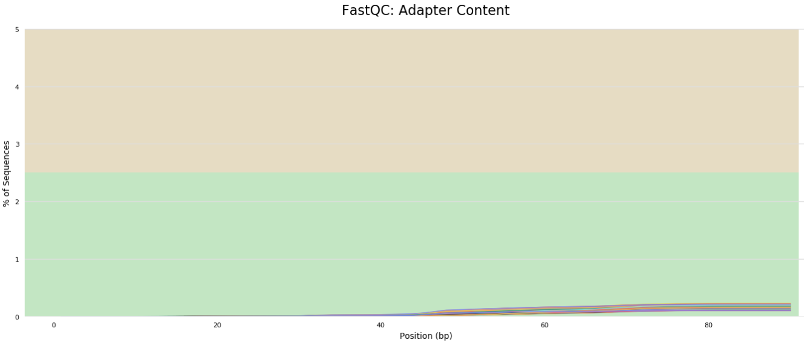
Workflow: HPC
raw
better base quality
(likelihood of accurate base call)
trimmed
bye bye adapters..
My notebook post on this…
https://github.com/SamGurr/SamJGurr_Lab_Notebook/blob/master/_posts/2021-02-03-An-odd-case-of-%25GC.md

Slide 30
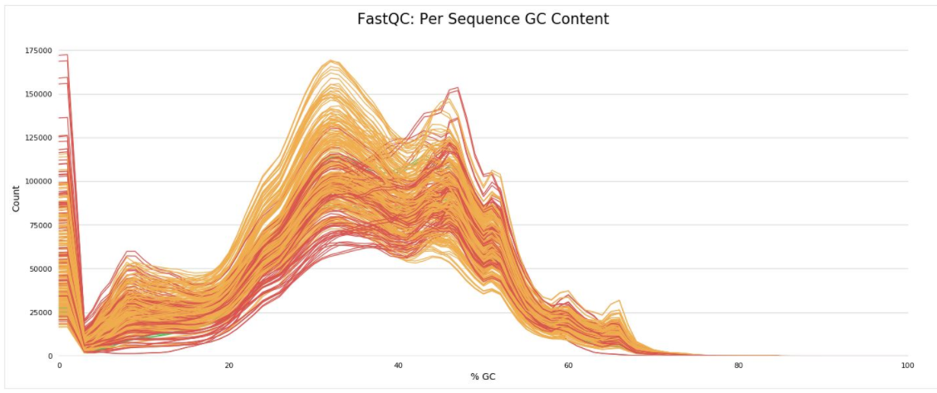
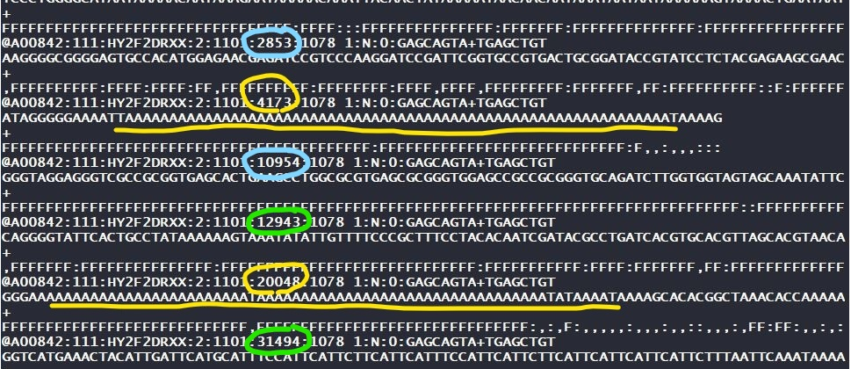
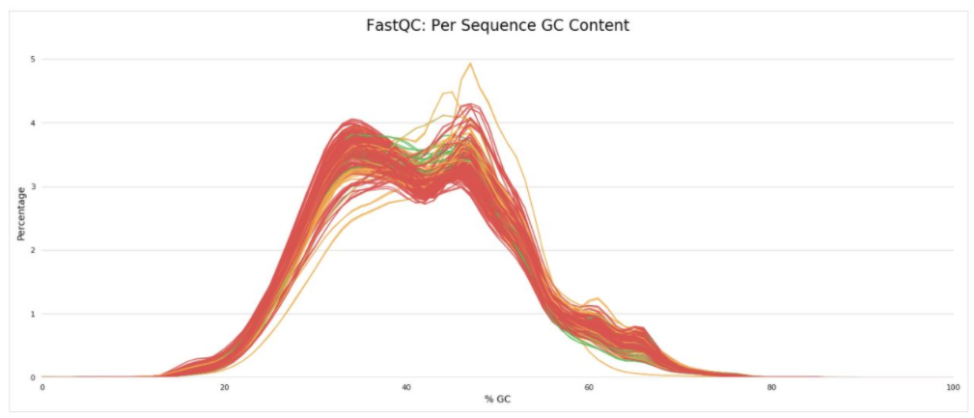
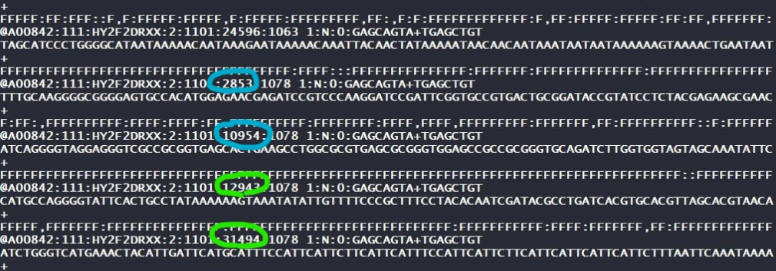
Workflow: HPC
raw
be aware of the polyA tail!
trimmed
My notebook post on this…
https://github.com/SamGurr/SamJGurr_Lab_Notebook/blob/master/_posts/2021-02-03-An-odd-case-of-%25GC.md

Slide 31
Workflow
‘clean’ data
raw data
Upon upload to HPC…
Cross-validate digital fingerprint (md5sum)
quality check and visualize report
QC and trim
i.e. fastp, trimmomatic, fastQC, etc..
report using
multiQC

Slide 32

Workflow: HPC
Map to reference
Quantify reads
raw data
‘clean’ data
HISAT2
(alignment program)
hisat2-build
hisat2
Create an index of reference genome/ transcriptome
alignment;
output Sequence Alignment Map (SAM) files
* Compress sam to bam w/samtools (binary format)
About HISAT2
http://daehwankimlab.github.io/hisat2/manual/

Slide 33
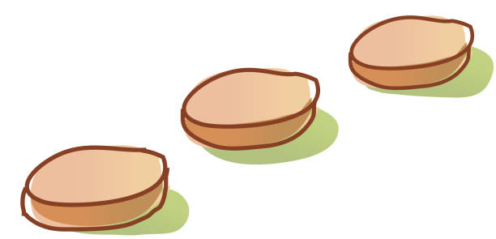
Workflow: HPC
Map to reference
Quantify reads
raw data
‘clean’ data
check here!
HISAT2 error report will inform you of your % mapping!
HISAT2
(alignment program)
hisat2-build
hisat2
Create an index of reference genome/ transcriptome
alignment;
output Sequence Alignment Map (SAM) files
* Compress sam to bam w/samtools (binary format)
About HISAT2
http://daehwankimlab.github.io/hisat2/manual/

Slide 34
Workflow: HPC
Quantify reads
‘clean’ data
Map to reference
raw data
Stringtie2
(assembly program)
stringtie
Abundance files (.gtf)
to sequence position and gene ID
loop your
bam alignment files
against annotated
mRNA reference
prepDE.py
https://github.com/gpertea/stringtie/blob/master/prepDE.py
About StringTie2
https://ccb.jhu.edu/software/stringtie/

Slide 35
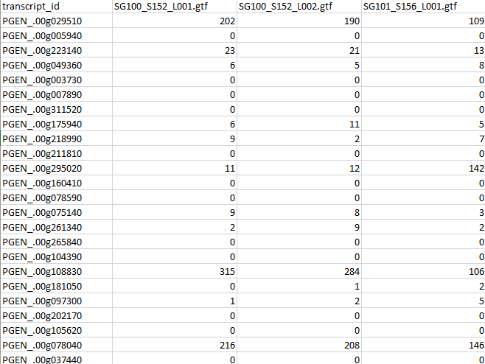
Workflow: HPC
Quantify reads

Slide 36

Workflow: HPC
Quantify reads
Stringtie2
(assembly program)

Slide 37

Briefly about analysis in R
DESeq2
edgeR
limma
WGCNA

Slide 38
Objectives
(I) Intro to RNAseq
Goals and how it works
Platforms, RNAseq vs. TagSeq
pros and cons
(II) Workflow
from HPC to R
(III) WGCNA (weighted gene correlation network analysis)
about this multivariate approach
…a dataset for our practical exercise!

Slide 39
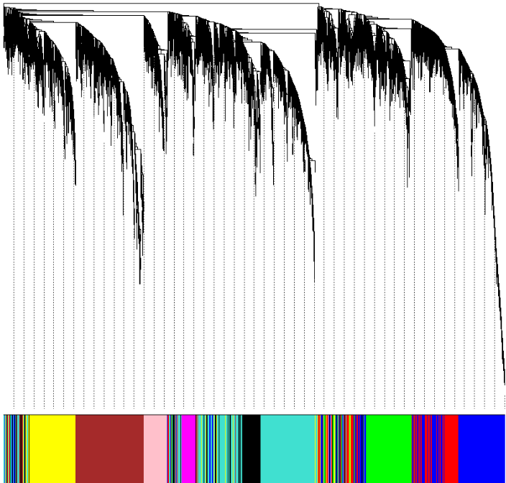
Overview of WGCNA
Y
Weighted Gene Co-expression Network Analysis
X
Data reduction technique
summarize how groups of genes relate to one another and in response to external sample traits
What does it do?
builds matrices to describe expression-level directionality
allows user to disentangle responses in a multivariate framework
in contrast to A vs. B in DESeq2, edgeR, etc.
Expression
A B C
Expression
Y
X
A B C
Y
X
Expression
A B C
treatment #2

Slide 40
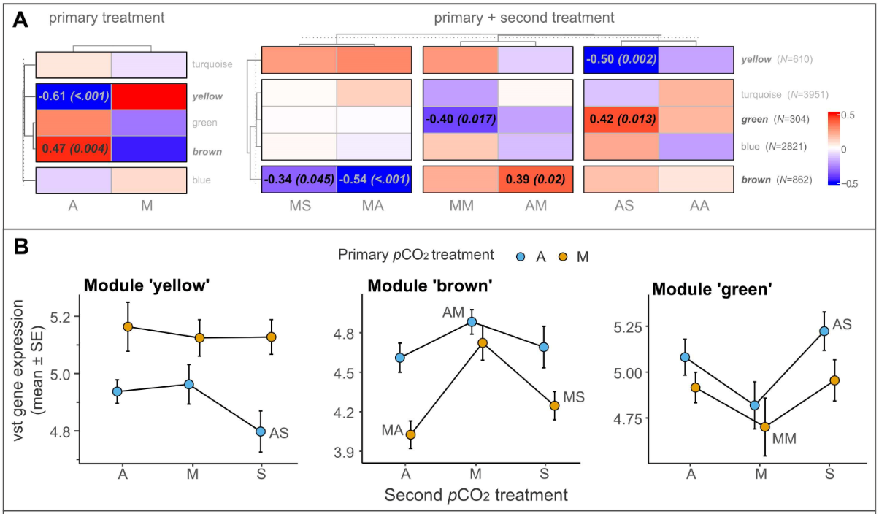
An example with categorical treatments as ‘traits’...
The end goal…

Slide 41
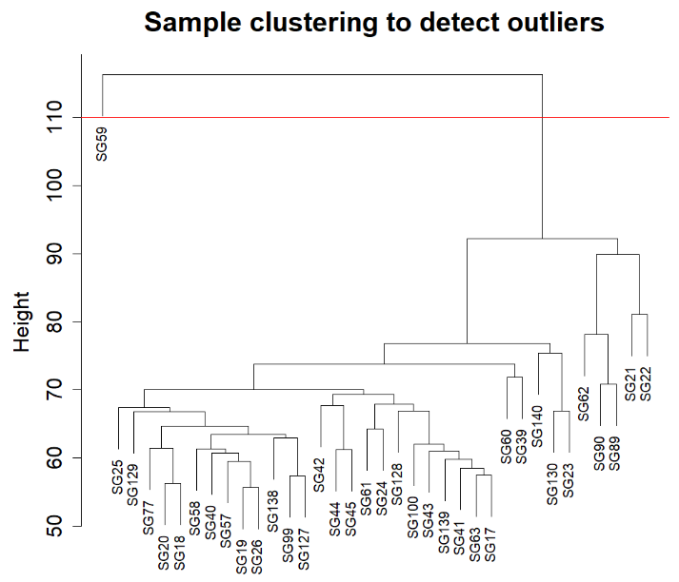
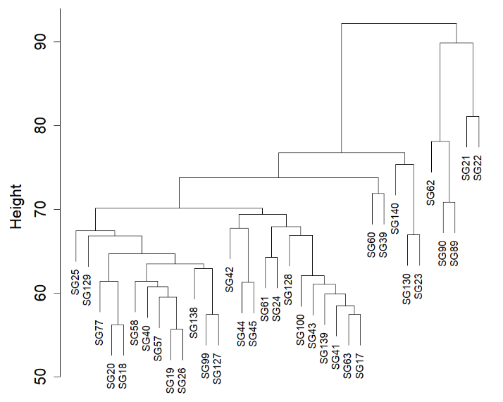
Getting started.. process sample tree and omit

Slide 42
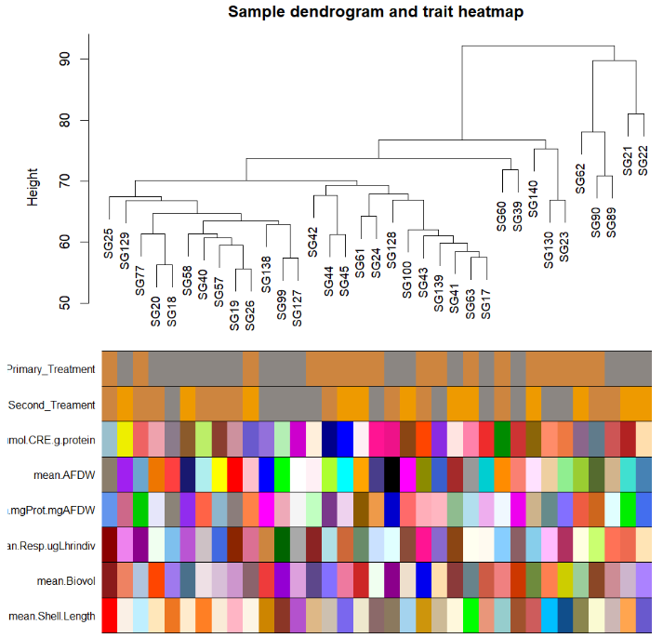
Getting started.. cluster samples by trait

Slide 43
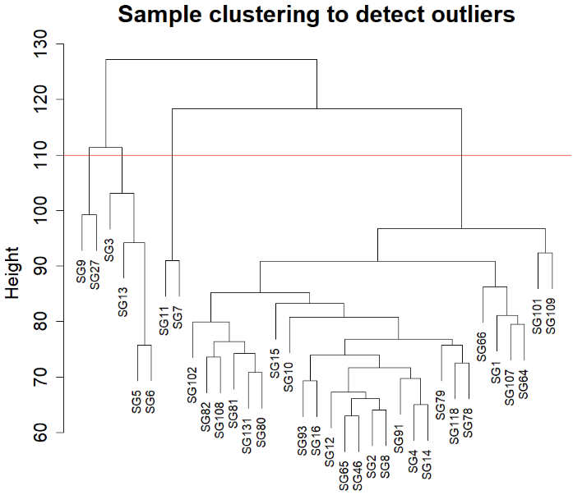
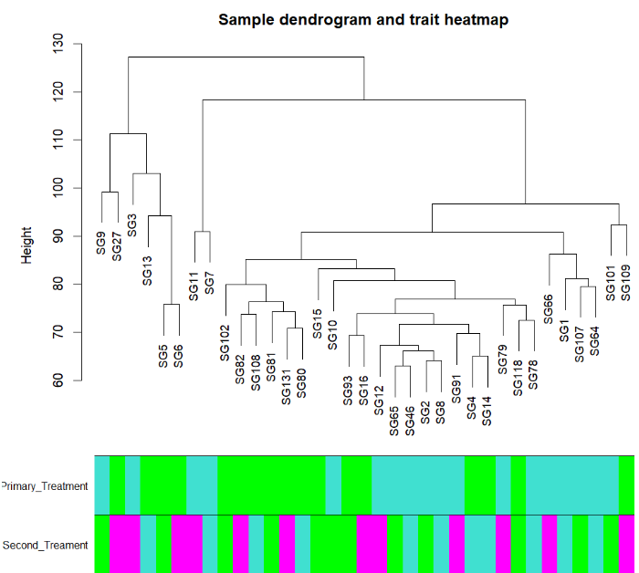
a good sanity check BEFORE omitting outliers
Getting started.. cluster samples by trait

Slide 44
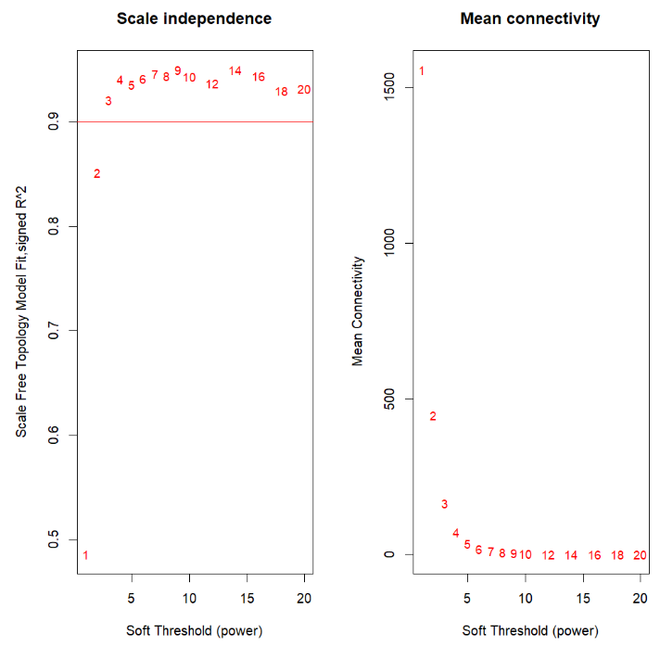
Stepwise module construction: Soft power
Purpose
Noise filtering
Soft power = 3
raises correlations to the absolute value of soft power - emphasizes high correlations and avoids ‘noise’ from low correlations

Slide 45
Stepwise module construction: Two matrices
Adjacency matrix (co-expression)
Calculates the network adjacency (co-expression) as either…
Distance
Correlation
Topological Overlap Matrix
Co-expression is not enough.. WGCNA adds network topology
Builds another adjacency matrix using the output above BUT considers network topology (output as ‘TOM’ matrix)

Slide 46
Stepwise module construction: Two matrices
Adjacency matrix (co-expression)
Calculates the network adjacency (co-expression) as either…
Distance
Correlation
Topological Overlap Matrix
Co-expression is not enough.. WGCNA adds network topology
Builds another adjacency matrix using the output above BUT considers network topology (output as ‘TOM’ matrix)

Slide 47
Stepwise module construction: Two matrices
Adjacency matrix (co-expression)
Calculates the network adjacency (co-expression) as either…
Distance
Correlation
Topological Overlap Matrix
Why? better estimate of ‘connectedness’ than from just expression- level/directionality (i.e. correlation) alone

Slide 48
Stepwise module construction: Adjacency matrix
signed
unsigned
a_{ij} = | (1 + cor(x_{i} , x_{j} )) / 2 | ^{β}
a_{ij} = | cor(x_{i} , x_{j} ) | ^{β}
^{β = soft power}

Slide 49
Stepwise module construction: Adjacency matrix
signed
unsigned
a_{ij} = | (1 + cor(x_{i} , x_{j} )) / 2 | ^{β}
a_{ij} = | cor(x_{i} , x_{j} ) | ^{β}
cor(x_{i} , x_{j} ) = 0.9
^{β} = 3
| (1 + 0.9) / 2 | ³ = 0.857
| 0.9 | ³ = 0.729
cor(x_{i} , x_{m} ) = -0.9
^{β} = 3
| (1 + -0.9) / 2 | ³ = 1.25 x 10⁻⁴
| (-0.9) | ³ = 0.729
Negative correlation leads to low adjacency value
Strong correlation in either direction yields the same adjacency value
^{β = soft power}

Slide 50
Stepwise module construction: Two types of adjacency matrix
signed
unsigned
- factors in the directionality of gene-to-gene correlations to create modules
- considers genes with strong negative relationships NOT connected
- modules based on the high / low correlative strength only
- considers genes with strong negative relationships connected

Slide 51
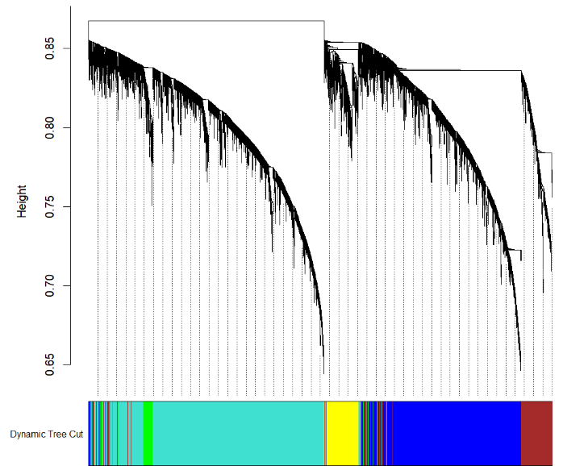
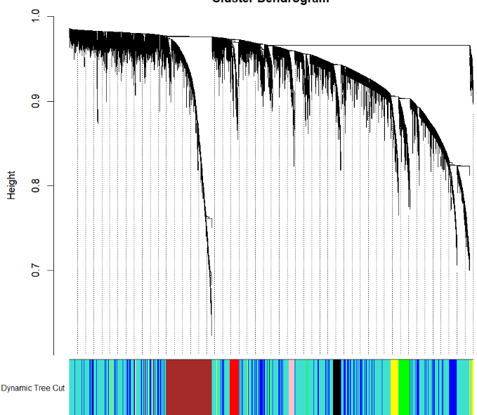
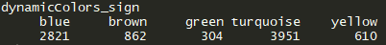
Stepwise module construction: TOM matrix and heiarchical clustering
signed
unsigned

Slide 52
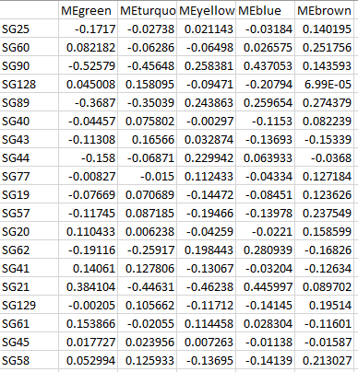
Comparing results: Eigengenes and treatment(s)
signed
Eigengenes
Meaningful data reduction to better compare modules
Easier to understand module-to-module patterns, reduce genes down to a single value representative of that module

Slide 53
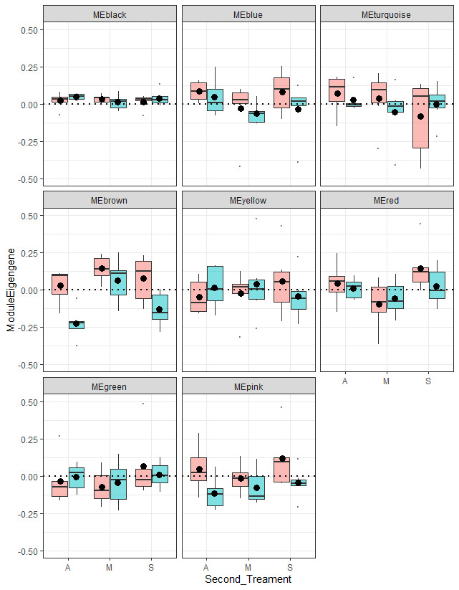
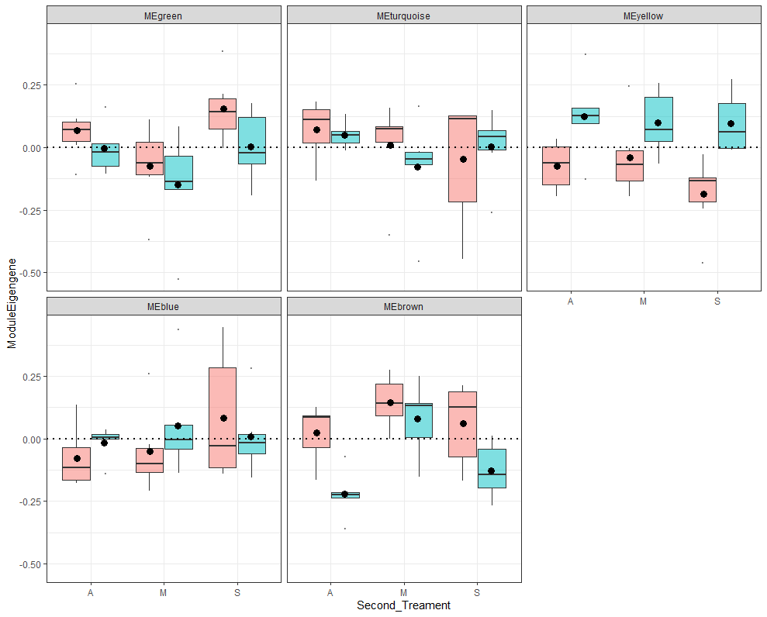
Comparing results: Eigengenes and treatment(s)
signed
unsigned
signed

Slide 54
Comparing results: Eigengenes and treatment(s)
signed
unsigned

Slide 55
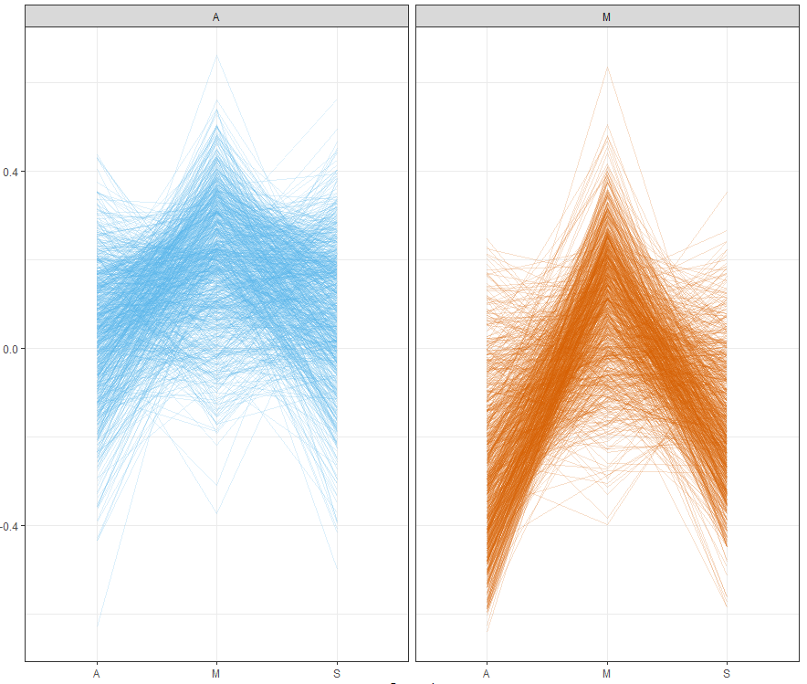
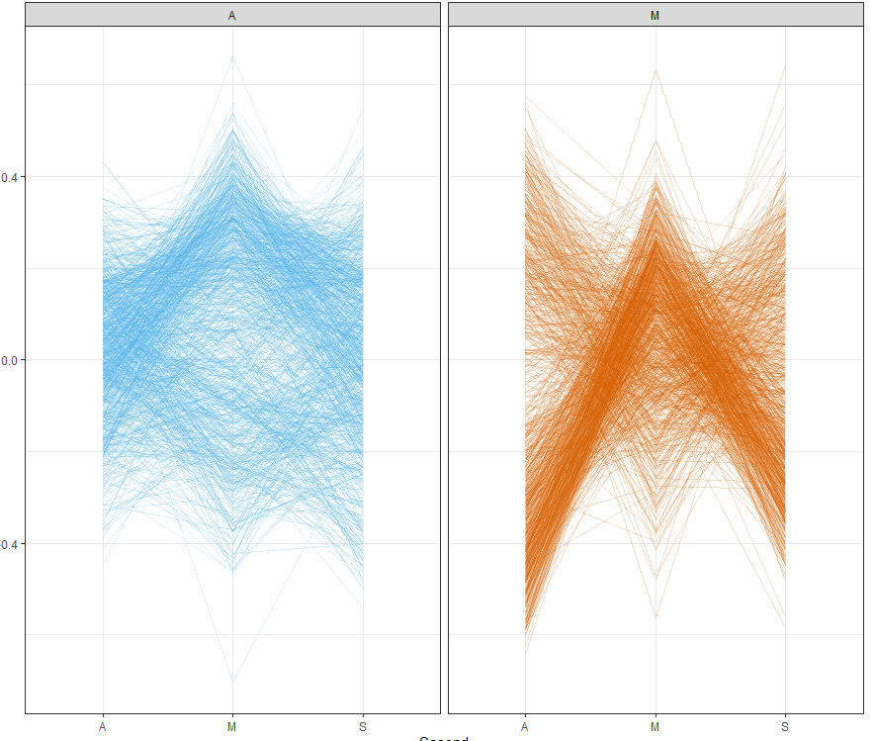
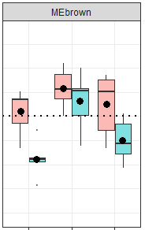
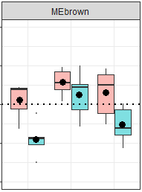
Comparing results: Eigengenes and treatment(s) ‘Module membership’
signed
unsigned

Slide 56
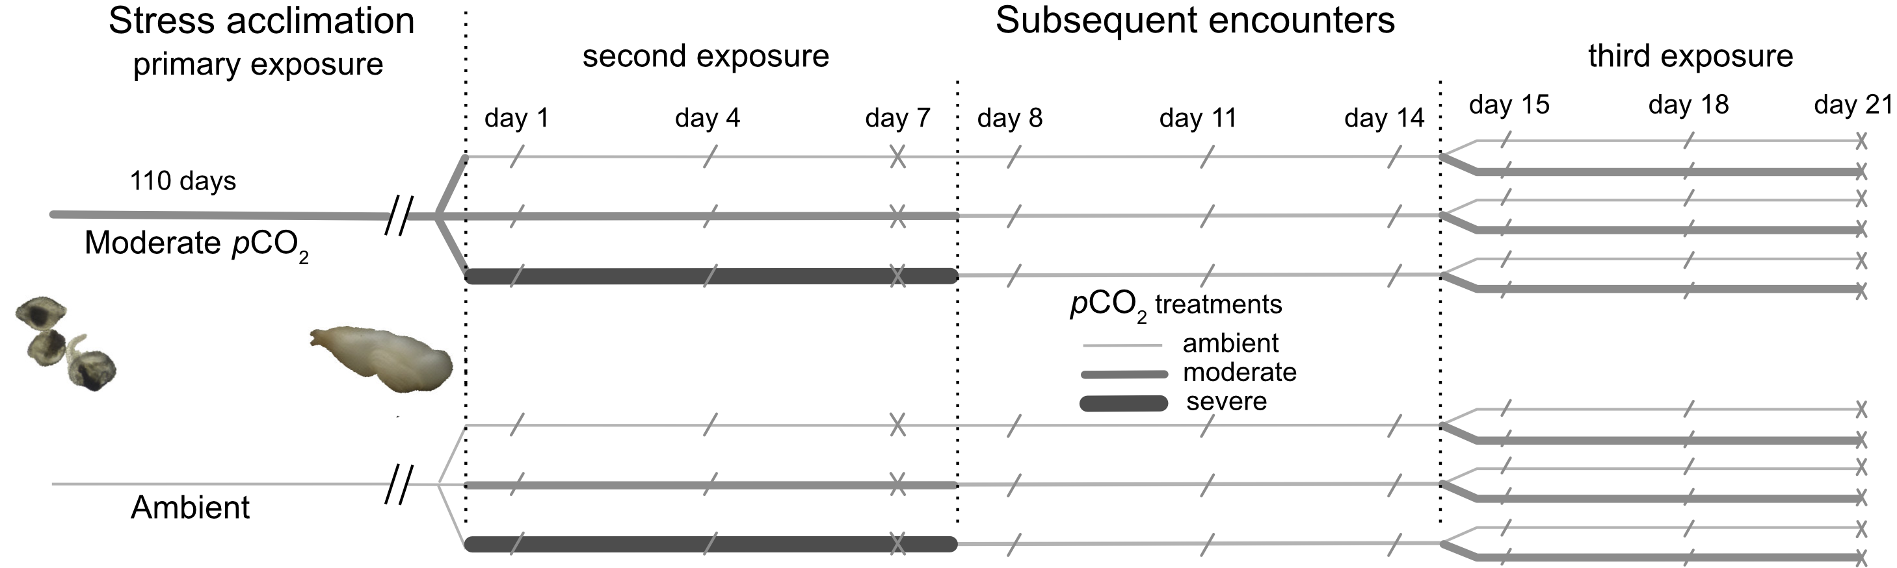
Practical exercise
Ambient
Moderate
Expression
Ambient
A M S
Moderate
Ambient
Severe
Moderate
Expression
Ambient
Moderate
A M S
Severe
Moderate
Expression
Ambient
A M S
treatment #2

